Slide 1
Deadlock Detection & Handling Methods
PRESENTATION BY Rupak Das & Bichitra Bora

Slide 2
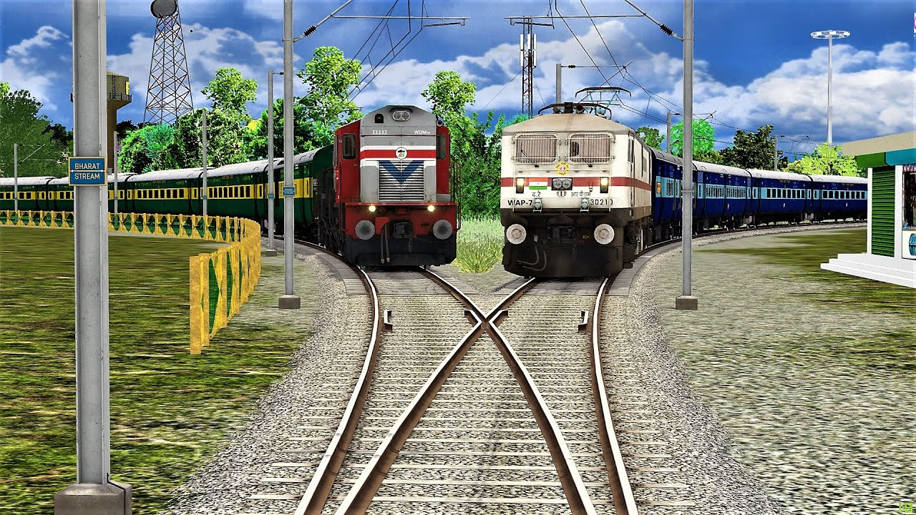
Introduction to Deadlock
A deadlock is a situation in an operating system (OS) where two or more processes are unable to proceed because they are each waiting for a resource that another process is holding. This can cause the system to become unresponsive until one of the processes is killed.
Realtime Example
Two trains are travelling on different tracks. If a crossing come, A train must hold or wait for other train to continue the journey. That waiting situation is referred as Deadlock situation.

Slide 3
Conditions for Deadlock
For a deadlock to occur, four conditions must be present simultaneously. These conditions are known as the Coffman conditions, and they describe how processes can become stuck waiting for resources. If even one of these conditions is not met, a deadlock cannot happen.
1. Mutual Exclusion
At least one resource must be in a non-shareable mode, meaning only one process can use it at a time. If another process requests that resource, it must wait until the resource is released.
Example: A printer can only be used by one process at a time. If Process A is using the printer, Process B must wait.

Slide 4
Conditions for Deadlock
2. Hold and Wait
A process is holding at least one resource and waiting to acquire additional resources that are currently held by other processes.
Example: Process A holds a printer and waits for a scanner, while Process B holds the scanner and waits for the printer.
3. No Preemption
Resources cannot be forcibly taken away from a process. Once a process has acquired a resource, it can only release it voluntarily, meaning other processes have to wait until the resource is released.
Example: If Process A is using the printer, the system can’t take it away from A and give it to B. Process B must wait until A finishes.

Slide 5
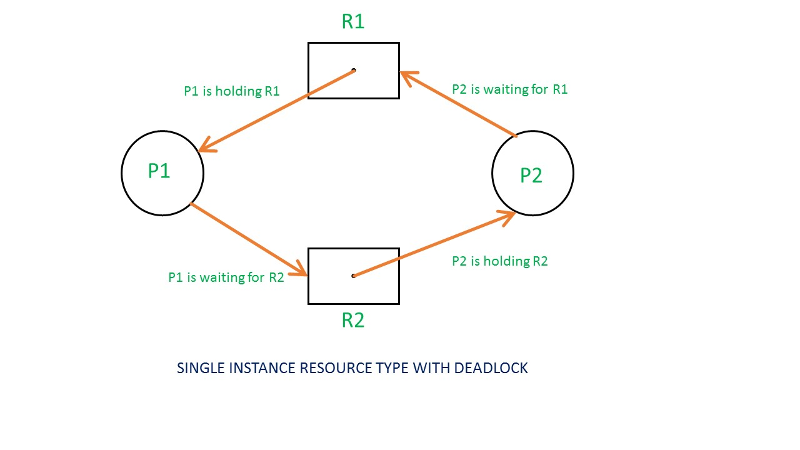
Conditions for Deadlock
4. Circular Wait
A set of processes are waiting for each other in a circular chain, where each process is waiting for a resource held by the next process in the chain.
Example: Process A is waiting for a resource held by Process B, Process B is waiting for a resource held by Process C, and Process C is waiting for a resource held by Process A. This forms a circular wait.

Slide 6
Deadlock Detection
Deadlock detection is a method used when a system allows deadlocks to occur but periodically checks for them. The system uses algorithms to identify if processes are stuck waiting for each other in a way that no one can proceed, known as a deadlock. Once detected, the system can then take steps to recover from it.
How Deadlock Detection Works
A system checks for deadlocks by examining resource usage and process behavior. It looks for cycles in resource allocation where each process is waiting for a resource held by another process. If such a cycle is found, the system declares that a deadlock has occurred.
Conditions for Deadlock Detection:
Multiple Processes Competing for Resources: Processes are competing for limited resources like memory, CPU, files, or devices.
Processes are Waiting Indefinitely: A process is waiting for a resource that will never be freed because another process in the system is holding it, creating a circular wait.

Slide 7
Deadlock Detection
Resource Allocation Graph (RAG)
A Resource Allocation Graph is used to detect deadlocks visually.
An arrow from a process to a resource means the process is requesting that resource.
An arrow from a resource to a process means the resource is allocated to that process.
Cycle in RAG:
If a cycle is found in the graph, it indicates a potential deadlock, because it means the processes are waiting for resources in a loop. In simpler cases, a cycle guarantees a deadlock, but for more complex systems (with multiple instances of resources), this may need further checking.

Slide 8
Deadlock Detection
Deadlock Detection Algorithms
1. Single Instance of Each Resource Type:
Wait-for Graph: In this simplified approach, each resource is assigned to only one process at a time. The system creates a wait-for graph by simplifying the Resource Allocation Graph, focusing only on processes waiting for each other.
If a cycle exists in the wait-for graph, deadlock is detected.
Example: Process P1 is waiting for a resource held by P2, and P2 is waiting for a resource held by P1. This creates a cycle, and the system detects the deadlock.
2. Multiple Instances of Resources (Banker’s Algorithm):
When multiple instances of the same resource type are available (e.g., several printers), deadlock detection becomes more complicated. The system tracks which resources are allocated and which are requested by processes, checking if there’s a way to fulfill all requests.
The system uses algorithms similar to the Banker’s Algorithm to check if a sequence of resource allocation could lead to a deadlock.
Example: P1 holds one printer and needs one more, while P2 holds the other printer. If both are waiting for each other to release a printer, the system detects this situation as a deadlock.

Slide 9
Deadlock Detection

Slide 10
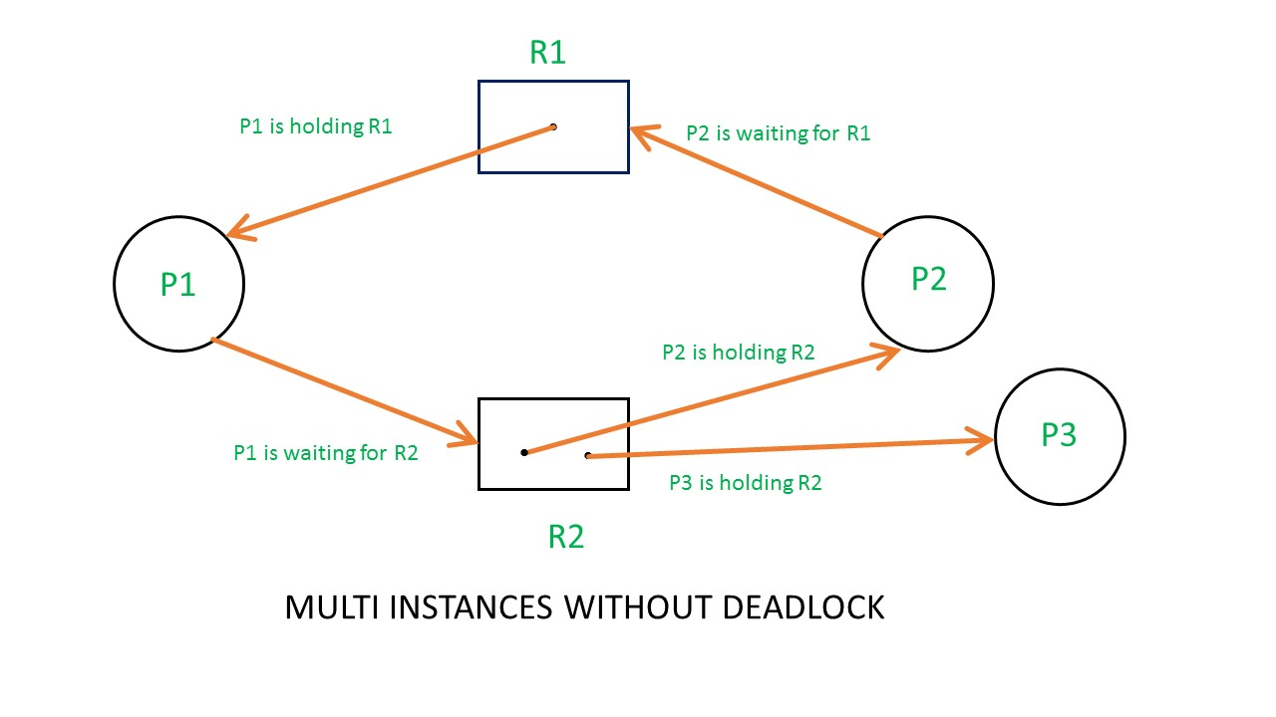
Deadlock Detection

Slide 11
Deadlock Detection
When to Perform Deadlock Detection
On Demand: The system checks for deadlock only when a process requests a resource and cannot get it. This avoids unnecessary overhead but may result in delayed detection.
Periodically: The system periodically runs a deadlock detection algorithm at regular intervals. This ensures that deadlocks are found in a timely manner, but it can be resource-intensive.

Slide 12
Deadlock Handling Techniques
Deadlock Ignorance
Deadlock Prevention
Deadlock Avoidance
Detection & Recovery

Slide 13
Deadlock Ignorance (Ostrich Algorithm)
The Deadlock Ignorance method, often humorously called the Ostrich Algorithm, is a strategy where the system deliberately chooses to ignore the problem of deadlocks. The idea is similar to an ostrich burying its head in the sand to avoid danger—hence the name. In this approach, no special mechanisms are used to detect, prevent, or avoid deadlocks.
Advantages:
Simplicity: Since no additional mechanisms are required, it keeps the system design simpler.
Performance: Systems may benefit from reduced overhead, as there’s no need for expensive resource-tracking algorithms or periodic deadlock checks.

Slide 14
Deadlock Ignorance (Ostrich Algorithm)
Disadvantages:
No Automated Recovery: When a deadlock happens, the system cannot resolve it on its own. Manual intervention is usually required to restart the affected processes or reboot the system.
Indefinite Blocking: In cases where deadlocks occur, processes may be indefinitely blocked, which can degrade system performance or even cause partial system failures.
Risk in Critical Systems: This method is generally inappropriate for critical systems (e.g., real-time systems or financial transaction systems) where deadlocks could cause significant harm or loss.

Slide 15
Deadlock Prevention
Deadlock Prevention is a strategy to ensure that a system never enters a deadlock state by proactively eliminating one or more of the four necessary conditions for deadlock to occur. These conditions are:
Mutual Exclusion
Hold and Wait
No Preemption
Circular Wait
By designing the system in such a way that one or more of these conditions never hold, deadlocks can be prevented entirely.

Slide 16
Deadlock Avoidance
Deadlock avoidance is a dynamic approach to ensure that the system never enters a deadlock state by carefully analyzing resource allocation requests and ensuring that a system always remains in a safe state. The key difference between deadlock avoidance and deadlock prevention is that avoidance doesn’t prevent deadlock conditions entirely; instead, it intelligently manages resource allocation to avoid unsafe states where deadlocks could occur.

Slide 17
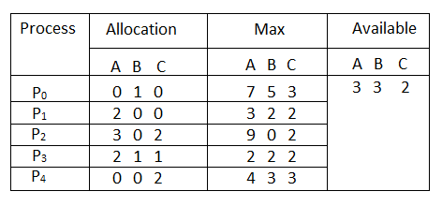
Banker’s Algorithm (Most Common Deadlock Avoidance Algorithm)
The Banker’s Algorithm is a smart way for computer systems to manage how programs use resources, like memory or CPU time. It helps prevent situations where programs get stuck and can’t finish their tasks, which is called deadlock. By keeping track of what resources each program needs and what’s available, the algorithm makes sure that programs only get what they need in a safe order. This helps computers run smoothly and efficiently, especially when lots of programs are running at the same time.

Slide 18
Deadlock Detection and Recovery
When the system doesn’t prevent deadlocks from occurring, it uses deadlock detection and recovery methods. This approach allows the system to detect when a deadlock happens and then recover from it to keep the system running.
1. Deadlock Detection
In this method, the system allows deadlocks to happen but periodically checks for them. It runs an algorithm to identify processes that are stuck in a deadlock by looking for a circular chain of resource dependencies (where each process is waiting for a resource held by another process in the chain).
How Detection Works:
The system checks the resource allocation graph (RAG). A cycle in this graph means deadlock has occurred.
For systems with multiple instances of resources, more complex algorithms (like the Banker’s Algorithm) are used to detect deadlocks.

Slide 19
Deadlock Detection and Recovery
2. Deadlock Recovery
Once a deadlock is detected, the system must recover to get things back on track. There are two main ways to recover:
a. Process Termination: The system ends one or more processes involved in the deadlock to break the cycle. This frees up resources so other processes can continue.
b. Resource Preemption: The system temporarily takes resources away from processes (called preemption) and gives them to other processes to break the deadlock.

Slide 20
Conclusion
In conclusion, deadlocks are a critical challenge in resource management systems, where processes become trapped waiting for resources held by each other. To address this issue, we have explored three main strategies: prevention, avoidance, and detection with recovery. Prevention involves implementing strict rules to eliminate deadlock conditions, while avoidance dynamically checks resource requests to ensure the system remains in a safe state. Detection allows deadlocks to occur but uses algorithms to identify and recover from them. Each strategy has its advantages and disadvantages, and the choice of approach depends on the specific system requirements. By understanding and effectively implementing these strategies, we can design systems that optimize resource usage and maintain operational efficiency, ultimately minimizing the risk of deadlocks.

